Slide 1
Binary Search Trees
Modified version of https://www.cs.unc.edu/~plaisted/comp550/15-btrees.ppt
Questions added from GATE

Slide 2
For large amounts of input, the linear access time of linked lists is prohibitive – weiss
Forms of trees(balanced BST, 2-3 trees) provide an average running time of O(log n) for most operations.
Comp 122, Spring 2004

Slide 3
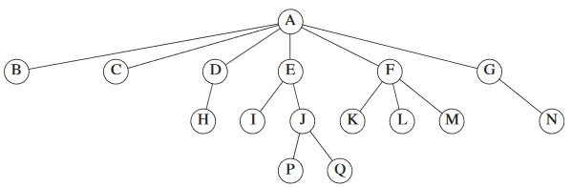
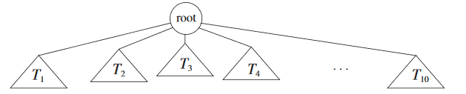
Root node: A
Child of D: H
Parent of D: A
Each node has
a subtree under it.
Comp 122, Spring 2004

Slide 4
Depth: The depth of a node is the number of edges in the unique path from the root to the node. Root depth=0
*Depth of a tree is equal to the depth of the deepest leaf.
Height: The height of a node is the length of the longest path from node to a leaf. All leaves are at height 0.
*The height of a tree is equal to the height of the root.
Depth of a tree is equal to the height of the tree.
Ancestor-Descendant: If there is a path from n1 to n 2,then n1 is an ancestor of n2 and n2 is a descendant of n1. If n1 = n2,then n1 is a proper ancestor of n2 and n2 is a proper descendant of n1

Slide 5
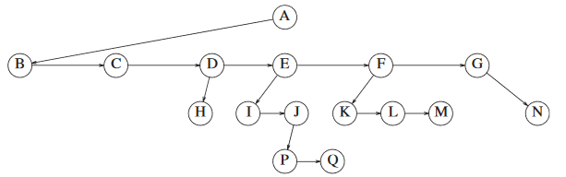
Implementation
When number of children is not known
Struct TreeNode
{ char * string;
TreeNode *firstChild;
TreeNode *nextSibling;
}
Node:
value: data
left: pointer to left child
right: pointer to right child
Comp 122, Spring 2004

Slide 6
Binary Trees
Recursive definition
  An empty tree is a binary tree
  A node can have not more than two children.
binary tree
56
26
200
18
28
190
213
12
24
27
Comp 122, Spring 2004

Slide 7
Binary Tree Implementation
When number of children is atmost two.
Struct TreeNode
{ char * string;
TreeNode *firstChild;
TreeNode *secondChild;
}
Comp 122, Spring 2004

Slide 8
Max depth of a binary tree of n nodes ?
Traversals
Inorder : Left Root Right
Preorder : Root Left Right
Postorder: Left Right Root
Comp 122, Spring 2004

Slide 9
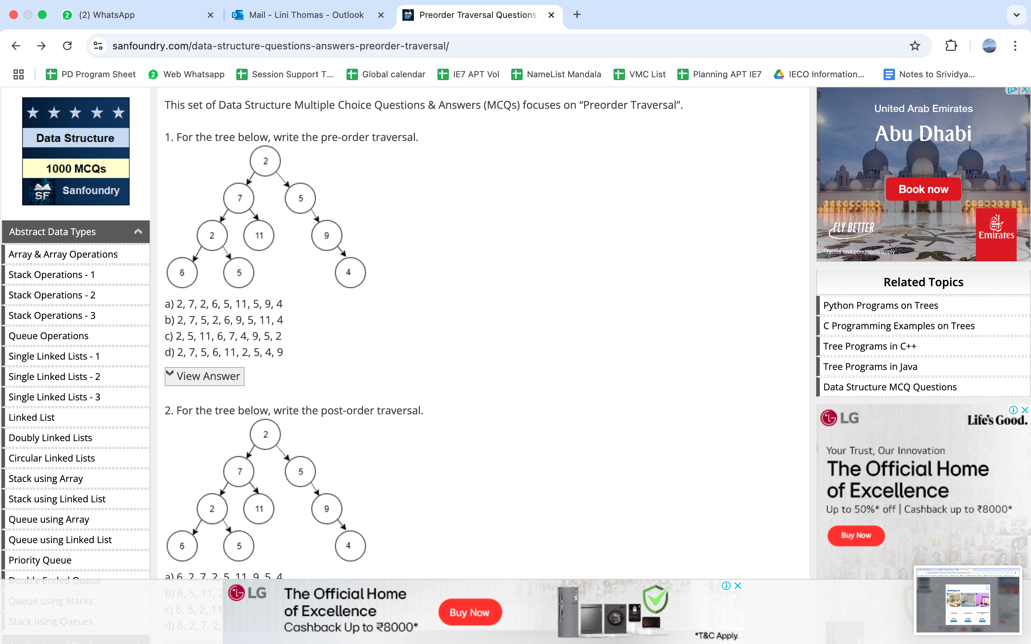
Write out the inorder, post order and pre order traversal of the above figure
Assume the digits 7, 5, 1, 8, 3, 6, 0, 9, 4, 2 are added in that sequence into a binary search tree that is initially empty. The binary search tree follows the standard natural number ordering. What is the resulting tree's inorder traversal sequence?
Consider the following data. The pre order traversal of a binary tree is A, B, E, C, D. The in order traversal of the same binary tree is B, E, A, D, C. The level order sequence for the binary tree is _________

Slide 10
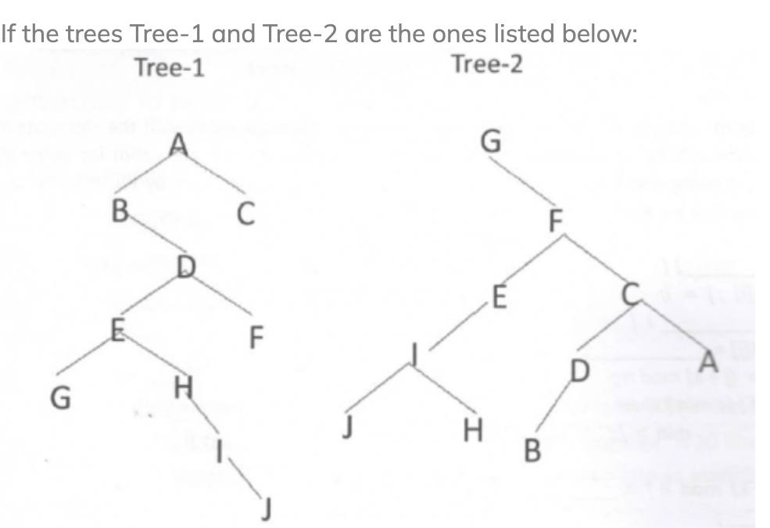
Which ordering of each tree
gives the same sequence
The in-order traversal of a tree resulted in FBGADCE.
Then the pre-order traversal of that tree would result in
FGBDECA
ABFGCDE
BFGCDEA
AFGBDEC

Slide 11
Inorder : Left Root Right
Preorder : Root Left Right
Postorder: Left Right Root
For a binary tree T, let the preorder traversal be [ 1, 2, 7, 3, 4, 5, 6 ] and inorder traversal be [2, 7, 1, 4, 3, 6, 5]. Can you construct the tree T.
Comp 122, Spring 2004

Slide 12
More definitions
A full binary tree (sometimes proper binary tree or 2-tree) is a tree in which every node other than the leaves has two children.
For a FULL binary tree T, let the preorder traversal be [ 1, 2, 3, 4, 5, 6, 7] and postorder traversal be [ 2, 4, 6, 7, 5, 3, 1 ] . Construct the full binary tree T.
Comp 122, Spring 2004

Slide 13
For a FULL binary tree T, let the preorder traversal be [ 1, 2, 3, 4, 5, 6, 7] and postorder traversal be [ 2, 4, 6, 7, 5, 3, 1 ] . Construct the full binary tree T.
--1 is the root and 2 is the root of left tree. All nodes left of 2 in postorder are in subtree of 2. this is empty.
Hence 3 is root of right subtree of 1.
Hence 4 is root of left subtree of 3 as in preorder and unvisited elemnts left of 4 in postoder belong to 4’s subtree. This is empty.
Hence 5 is right subtree of 3. unvisited elements left of 5 as 6 & 7. being a full binary tree they are left and right child of 5
Comp 122, Spring 2004

Slide 14
More definitions
A full binary tree (sometimes proper binary tree or 2-tree) is a tree in which every node other than the leaves has two children.
A complete binary tree is a binary tree in which every level, except possibly the last, is completely filled, and all nodes are as far left as possible.
Comp 122, Spring 2004

Slide 15
Binary Search Trees
View today as data structures that can support
dynamic set operations.
  Search, Minimum, Maximum, Predecessor, Successor, Insert, and Delete.
Can be used to build
  Dictionaries.
  Priority Queues.
Basic operations take time proportional to the height of the tree – O(h).
Comp 122, Spring 2004

Slide 16
BST – Representation
Represented by a linked data structure of nodes.
root(T) points to the root of tree T.
Each node contains fields:
  key
  left – pointer to left child: root of left subtree.
  right – pointer to right child : root of right subtree.
  p – pointer to parent. p[root[T]] = NIL (optional).
Comp 122, Spring 2004

Slide 17
Binary Search Tree Property
Stored keys must satisfy the binary search tree property.
  ∀ y in left subtree of x, then key[y] ≤ key[x].
  ∀ y in right subtree of x, then key[y] ≥ key[x].
  Given a BST, how can I
  Print the sorted element set?
56
26
200
18
28
190
213
12
24
27
Comp 122, Spring 2004

Slide 18
Inorder Traversal
The binary-search-tree property allows the keys of a binary search tree to be printed, in (monotonically increasing) order, recursively.
Inorder-Tree-Walk (x)
1. if x ≠ NIL
2. then Inorder-Tree-Walk(left[x])
3. print key[x]
4. Inorder-Tree-Walk(right[x])
56
26
200
18
28
190
213
12
24
27
How long does the walk take?
Comp 122, Spring 2004

Slide 19
Operations
Querying for a key
Find Min, Max
Find Successor, Predecessor
Insert, Delete
Comp 122, Spring 2004

Slide 20
Querying a Binary Search Tree
Comp 122, Spring 2004

Slide 21
Querying a Binary Search Tree
All dynamic-set search operations can be supported in O(h) time.
h = Θ(lg n) for a balanced binary tree (and for an average tree built by adding nodes in random order.)
h = Θ(n) for an unbalanced tree that resembles a linear chain of n nodes in the worst case.
Comp 122, Spring 2004

Slide 22
Tree Search
Tree-Search(x, k)
1. if x = NIL or k = key[x]
2. then return x
3. if k < key[x]
4. then return Tree-Search(left[x], k)
5. else return Tree-Search(right[x], k)
56
26
200
Running time: O(h)
18
28
190
213
12
24
27
Comp 122, Spring 2004

Slide 23
Iterative Tree Search
Iterative-Tree-Search(x, k)
1. while x ≠ NIL and k ≠ key[x]
2. do if k < key[x]
3. then x ← left[x]
4. else x ← right[x]
5. return x
56
26
200
18
28
190
213
12
24
27
The iterative tree search is more efficient on most computers.
The recursive tree search is more straightforward.
Comp 122, Spring 2004

Slide 24
Finding Min & Max
Comp 122, Spring 2004

Slide 25
Finding Min & Max
The binary-search-tree property guarantees that:
  The minimum is located at the ?
  The maximum is located at the ?
Try writing the code
Q: How long do they take?
Comp 122, Spring 2004

Slide 26
Finding Min & Max
The binary-search-tree property guarantees that:
  The minimum is located at the left-most node.
  The maximum is located at the right-most node.
Tree-Minimum(x) Tree-Maximum(x)
1. while left[x] ≠ NIL 1. while right[x] ≠ NIL
2. do x ← left[x] 2. do x ← right[x]
3. return x 3. return x
Q: How long do they take?
Comp 122, Spring 2004

Slide 27
Predecessor and Successor
56
26
200
18
28
190
213
12
24
27
Comp 122, Spring 2004

Slide 28
Predecessor and Successor
Successor of node x is the node y such that key[y] is the smallest key greater than key[x].
The successor of the largest key is NIL.
Search consists of two cases.
  If node x has a non-empty right subtree, then x’s successor is the minimum in the right subtree of x.
  If node x has an empty right subtree, then:
    As long as we move to the left up the tree (move up through right children), we are visiting smaller keys.
    x’s successor y is the node that x is the predecessor of (x is the maximum in y’s left subtree).
    In other words, x’s successor y, is the lowest ancestor of x whose left child is also an ancestor of x.
Comp 122, Spring 2004

Slide 29
Pseudo-code for Successor
Tree-Successor(x)
if right[x] ≠ NIL
2. then return Tree-Minimum(right[x])
3. y ← p[x]
4. while y ≠ NIL and x = right[y]
5. do x ← y
6. y ← p[y]
7. return y
56
26
200
Code for predecessor is symmetric.
Running time: O(h)
18
28
190
213
12
24
27
Comp 122, Spring 2004

Slide 30
BST Insertion – Pseudocode
Change the dynamic set represented by a BST.
Ensure the binary-search-tree property holds after change.
Insertion is easier than deletion.
Tree-Insert(T, z)
y ← NIL
x ← root[T]
while x ≠ NIL
do y ← x
if key[z] < key[x]
then x ← left[x]
else x ← right[x]
p[z] ← y
if y = NIL (inserting first node)
then root[t] ← z
else if key[z] < key[y]
then left[y] ← z
else right[y] ← z
56
26
200
18
28
190
213
12
24
27
Comp 122, Spring 2004

Slide 31
Analysis of Insertion
Initialization: O(1)
While loop in lines 3-7 searches for place to insert z, maintaining parent y.
This takes O(h) time.
Lines 8-13 insert the value: O(1)
⇒ TOTAL: O(h) time to insert a node.
Tree-Insert(T, z)
y ← NIL
x ← root[T]
while x ≠ NIL
do y ← x
if key[z] < key[x]
then x ← left[x]
else x ← right[x]
p[z] ← y
if y = NIL
then root[t] ← z
else if key[z] < key[y]
then left[y] ← z
else right[y] ← z
Comp 122, Spring 2004

Slide 32
Exercise: Sorting Using BSTs
Sort (A)
for i ← 1 to n
do tree-insert(A[i])
inorder-tree-walk(root)
  What are the worst case and best case running times?
  In practice, how would this compare to other sorting algorithms?
Comp 122, Spring 2004

Slide 33
Tree-Delete (T, x)
if x has no children ♦ case 0
then remove x
if x has one child ♦ case 1
then make p[x] point to child
if x has two children (subtrees) ♦ case 2
then swap x with its successor
perform case 0 or case 1 to delete it
⇒ TOTAL: O(h) time to delete a node
Comp 122, Spring 2004

Slide 34
Deletion – Pseudocode
Tree-Delete(T, z)
/* Determine which node to splice out: either z or z’s successor. */
if left[z] = NIL or right[z] = NIL
then y ← z
else y ← Tree-Successor[z]
/* Set x to a non-NIL child of x, or to NIL if y has no children. */
if left[y] ≠ NIL
then x ← left[y]
else x ← right[y]
/* y is removed from the tree by manipulating pointers of p[y] and x */
if x ≠ NIL
then p[x] ← p[y]
/* Continued on next slide */
Comp 122, Spring 2004

Slide 35
Deletion – Pseudocode
Tree-Delete(T, z) (Contd. from previous slide)
if p[y] = NIL
then root[T] ← x
else if y ← left[p[i]]
then left[p[y]] ← x
else right[p[y]] ← x
/* If z’s successor was spliced out, copy its data into z */
if y ≠ z
then key[z] ← key[y]
copy y’s satellite data into z.
return y
Comp 122, Spring 2004

Slide 36
Correctness of Tree-Delete
How do we know case 2 should go to case 0 or case 1 instead of back to case 2?
  Because when x has 2 children, its successor is the minimum in its right subtree, and that successor has no left child (hence 0 or 1 child).
Equivalently, we could swap with predecessor instead of successor. It might be good to alternate to avoid creating lopsided tree.
Comp 122, Spring 2004

